Slide 1
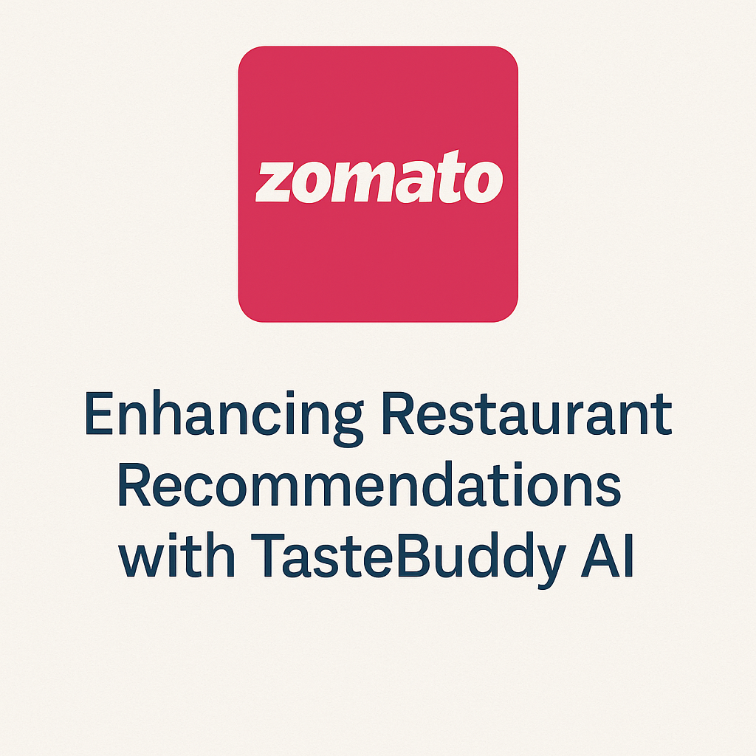
Taste-Buddy AI: An Intelligent Food Recommendation System Using Zomato Data Subtitle: Powered by Machine Learning and Large Language Models
Presenter Name : Deepak Kumar Patro
Date : 17/06/2025

Slide 2
Executive summary
Built using deep analysis of Zomato’s restaurant ecosystem
Extracted key insights on user behaviour, pricing patterns, and satisfaction levels
Introduced Taste-Buddy AI — a smart voice/image-enabled assistant that understands users
Enhances personalization, engagement, accessibility, and decision-making across the platform

Slide 3
Problem Statement
New players like Rapido's "OWNLY" are entering the food delivery market with aggressive pricing and lower commissions
Zomato faces decreasing user retention, and restaurants are expressing concerns over high fees and opaque charges
The food-tech space is increasingly crowded and competitive, especially in Tier 1 cities
There's a growing demand for a smarter, more intuitive, and inclusive way for users to discover and order food

Slide 4
Industry Context & Trends
India's online food delivery market is projected to reach $15B by 2029, driven by rising internet penetration and lifestyle changes
Surge pricing and high platform commissions are leading to customer dissatisfaction and growing tension with restaurant partners
Fierce competition from quick commerce platforms like Zepto, Blinkit, and Flipkart Minutes is reshaping delivery expectations
Rapido's entry with its "OWNLY" platform offering 8–15% commissions is challenging traditional models (Zomato 20–35%)
Growing demand for hyperlocal personalization, faster delivery, and more inclusive tech experiences

Slide 5

Dataset overview
Source: Kaggle (Zomato.csv), a real-world dataset representing restaurants across major Indian cities
Key Attributes:
Restaurant name, cuisine types, average cost, user rating, total votes
Location, delivery availability, and service type (e.g.,
dine-in, takeaway)
Purpose:
Train ML models for restaurant rating prediction, price tier classification, and cuisine/sentiment analysis
Enable deeper understanding of regional preferences and market behavior

Slide 6
Exploratory Data Analysis
Top Cuisines: North Indian, Chinese, and South Indian cuisines dominate user preferences, indicating a strong inclination towards comfort food.
Location Hotspots: Neighborhoods like BTM, Koramangala, and JP Nagar emerge as dense restaurant zones with high user engagement.
Rating Patterns: The majority of restaurants fall within the 3.0–4.5 rating range, suggesting an overall positive but competitive landscape.
Cost Trends: Most dining options are priced between ₹200–₹400, aligning with mid-range affordability for urban consumers.
Delivery Insights: Online delivery shows significant traction in Tier 1 cities, highlighting the urban appetite for convenience-first services.
6

Slide 7

ML Models Developed
Rating Classifier (XGBoost) – F1: 0.85
Price Classifier (XGBoost) – F1: 0.78
Cuisine Analyzer – K-Means + Apriori
Sentiment Analysis – LSTM/Transformer
7

Slide 8
Feature Engineering
Addressed missing data through imputation strategies to ensure model stability
Applied SMOTE to handle class imbalance in rating and pricing classification tasks
Used label encoding and one-hot encoding for categorical features like cuisines and location
Engineered new features such as:
Cost per Person = Average cost / number of people
Cuisine Buckets = Simplified cuisine categories
Regional Clusters = Grouped areas based on food trends and price segments
8

Slide 9
Flask API Integration
Developed a RESTful API using Flask to deploy the trained
machine learning models
End points:
/predict_rating – Accepts user input (e.g., cost, location) to classify restaurant rating
/predict_price – Predicts the pricing tier based on input cuisine and area
/analyze_sentiment – Classifies user review text as positive or negative
Architecture Highlights:
Models are serialized using pickle for efficient loading
Outputs are returned in real-time JSON format
CORS enabled to allow web app integration and secure cross-origin requests

Slide 10
Introducing Taste-Buddy AI
Taste-Buddy AI is a voice- and image-enabled food assistant seamlessly integrated into the Zomato app
Delivers hyper-personalized recommendations based on past orders, regional tastes, and time of day
Promotes cultural inclusivity by suggesting local delicacies and regional combos
Enables hands-free interaction for users with disabilities or limited digital literacy
Powered by fine-tuned LLMs and ML models, it adapts through continuous feedback

Slide 11
Technical Architecture
Hybrid Architecture: Seamlessly integrates LLMs (e.g., GPT variants) with traditional ML models
Modular API Design: Core services are exposed via REST APIs with clear separation between modules
Feedback Loop Integration: Learns from user behavior and feedback to improve recommendations over time
Key Components:
Recommendation Engine – Personalized suggestions based on behaviour and region
Discount Engine – Dynamically calculates offers based on combos, time, and location
Cuisine Mapper – Maps and clusters popular cuisines per locality
Deployment:
Real-time backend served using Flask APIs
Supports mobile, web, and future IoT/kiosk integrations

Slide 12
Business Value to Zomato
Drives Inclusivity & Accessibility: Taste-Buddy AI enables voice and image-based food ordering for users with disabilities or low digital literacy
Boosts User Retention & Engagement: Personalized combos and cultural dishes increase stickiness and repeat orders
Enhances Revenue per Order: Smart combo suggestions and dynamic discounts encourage upselling and larger cart sizes
Strengthens Restaurant Partnerships: Transparent suggestions reduce commission dependency, improving partner trust
Expands into New Ecosystems: Easily deployable in kiosks, schools, hospitals, and public spaces, supporting Zomato’s long-term omni-channel goals
12

Slide 13
Model Evaluation
F1 Scores:
Rating Classifier: 0.85
Price Tier Classifier: 0.78
Cuisine Clustering Score: 0.63
Sentiment Model F1: ~0.80

Slide 14
Conclusion
This journey started with data but evolved into an innovative, user-first solution
Taste-Buddy AI redefines how people interact with food platforms making the experience seamless, intelligent, and inclusive
By combining emotional intelligence with predictive analytics, Zomato is poised to lead the next wave of food-tech evolution
Taste-Buddy AI is not just a product it's a vision for the future of food discovery and digital accessibility

Slide 15
Future Scope
Regional language integration
IoT + Smart speaker compatibility
Real-time Zomato API integration
Personalized nutrition insights

Slide 16
Thank you
Deepak Kumar Patro
deepakpatro73@gmail.com
www.linkedin.com/in/deepak-patro-2a0330228

